Slide 1
Introduction
to
Postmodernism

Slide 2

Introduction
to
Postmodernism
Appropriation
Notes:
This week we are going to look into what we mean when we use the term 'Postmodernism'. It's a term you hear a lot when talking about contemporary art, but it can mean a lot of different things so the definition is hard to pin down. I want to cover a couple concepts that often are used when describing some of the concerns of Postmodernism: let's start with Appropriation.

Slide 3
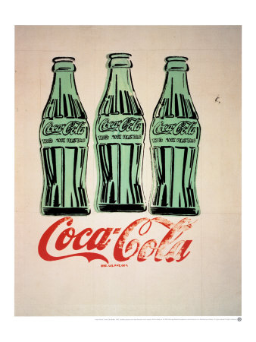
Notes:
Appropriation is the act of taking something that already exists out in the world and reusing it in a way that creates new meaning. It covers everything from the image of a Coke bottle as we saw with Andy Warhol to the sampling that is so common in music today.

Slide 4
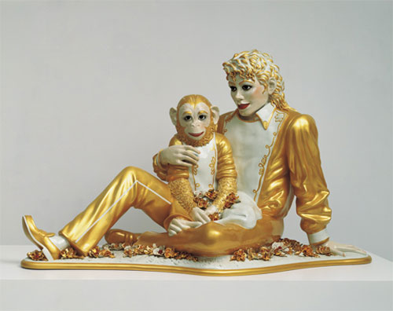
Notes:
Jeff Koons, who continues the trend of pop art, appropriates pop culture and brings it into the artworld, such as he did with this life size porcelain sculpture of Michael Jackson.

Slide 5
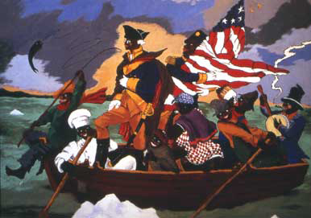
Notes:
Sometimes appropriation is more critical in it's message, but still draws from the culture at large. In this way appropriation can becomes satire, such as this piece we saw by Robert Colescott...

Slide 6
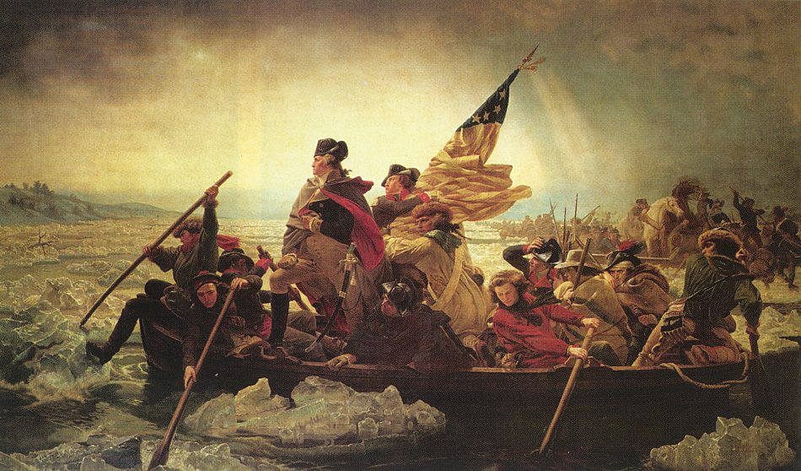
Notes:
Colescott appropriated the composition of this painting by Emanuel Gottlieb Leutze from 1851. Colescott draws from the patriotic fervor found in this image to contrast it with the African American experience.

Slide 7
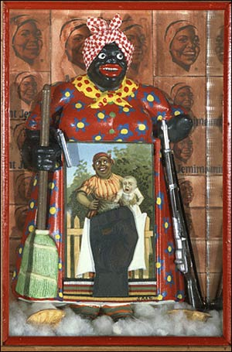
Notes:
Artist like Betye Sarr appropriate actual objects and combine them into new artworks, as we see here in this collage that is made by assembling found objects into a sculpture that challenges racial stereotypes.

Slide 8
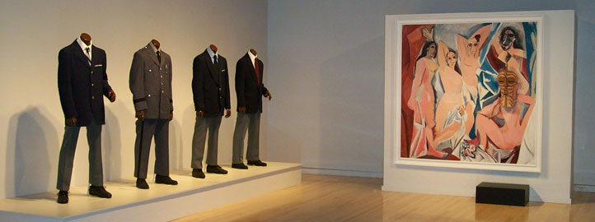
Notes:
We saw this in the early work of Fred Wilson as well, where the meaning is created though the reorganization of appropriated material from museum collections.

Slide 9
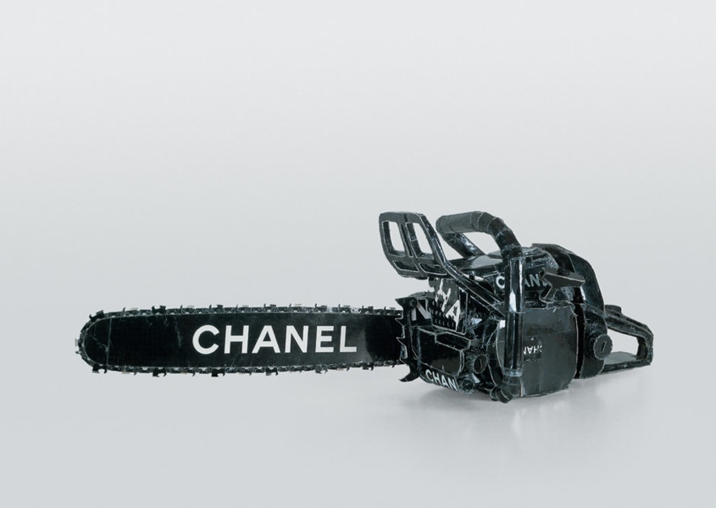
Notes:
Some artists such as Tom Sachs show both a fascination with as well as a critique of popular culture, as we see in this chain saw he made out of a Chanel shopping bag. He has combined well known brand names with menacing images that include guillotines, death camps, nuclear threats and toilets. We'll see him later in the course.

Slide 10
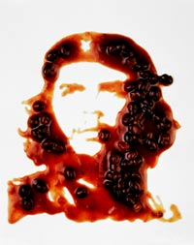
Notes:
Photographer Vic Muniz displays a similar love of appropriated imagery refashioned in unusual material. Here he has reproduced the famous image of Che Guevara out of baked beans and photographed the result.

Slide 11
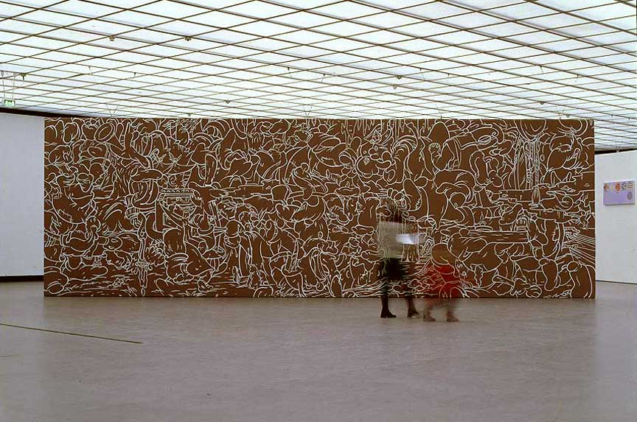
Notes:
In the second half of this semester, we will see many instances of appropriation used to blur the line between artistic styles. This impressive wall piece by Arturo Herrera might at first look like a non-representational Abstract Expressionist painting...

Slide 12
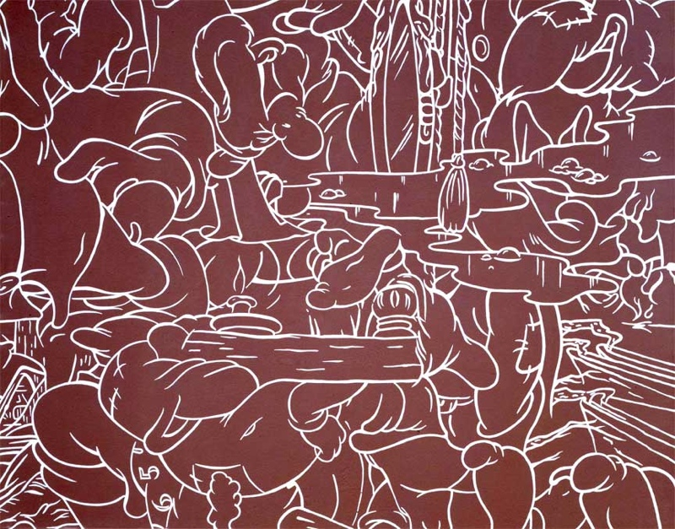
Notes:
... On closer inspection, however, we notice that all the lines are all appropriated from Disney. Cartoon dwarves, ropes, water and trees are collaged together in a way that both obscures and enhances the original images.

Slide 13
Images:
Andy Warhol, 3 Coke Bottles
Jeff Koons, Michael Jackson and Bubbles, 1988
Robert Colescott, George Washington Carver Crossing the Deleware, 1977
Emanuel Gottlieb Leutze, Washington Crossing the Delaware, 1851
Betye Saar, Liberation of Aunt Jemima, 1972
Fred Wilson, Guarded View, 1991
Tom Sachs, Chanel Chain Saw, 1996
Vic Muniz, Che Guevara
Arturo Herrera, All I Ask, 1999
Notes:
Andy Warhol, 3 Coke Bottles
Jeff Koons, Michael Jackson and Bubbles, 1988
Robert Colescott, George Washington Carver Crossing the Deleware, 1977
Emanuel Gottlieb Leutze, Washington Crossing the Delaware, 1851
Betye Saar, Liberation of Aunt Jemima, 1972
Fred Wilson, Guarded View, 1991
Tom Sachs, Chanel Chain Saw, 1996
Vic Muniz, Che Guevara
Arturo Herrera, All I Ask, 1999

